Slide 1
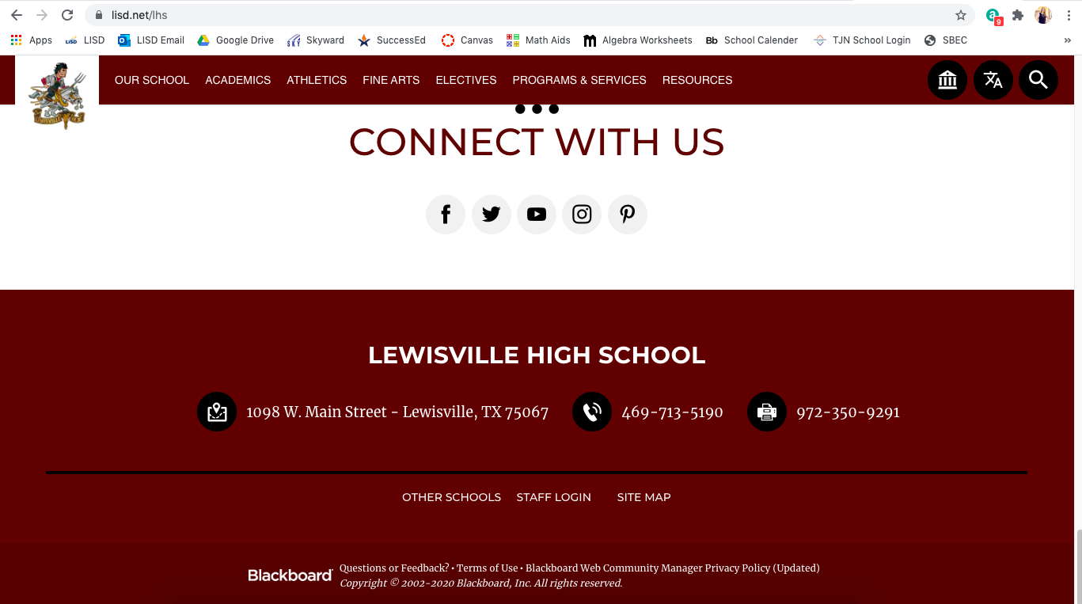
Go to the LHS-Main Website: www.lisd.net/lhs
Step 1: Login using your LISD username and password (Bottom of page)

Slide 2
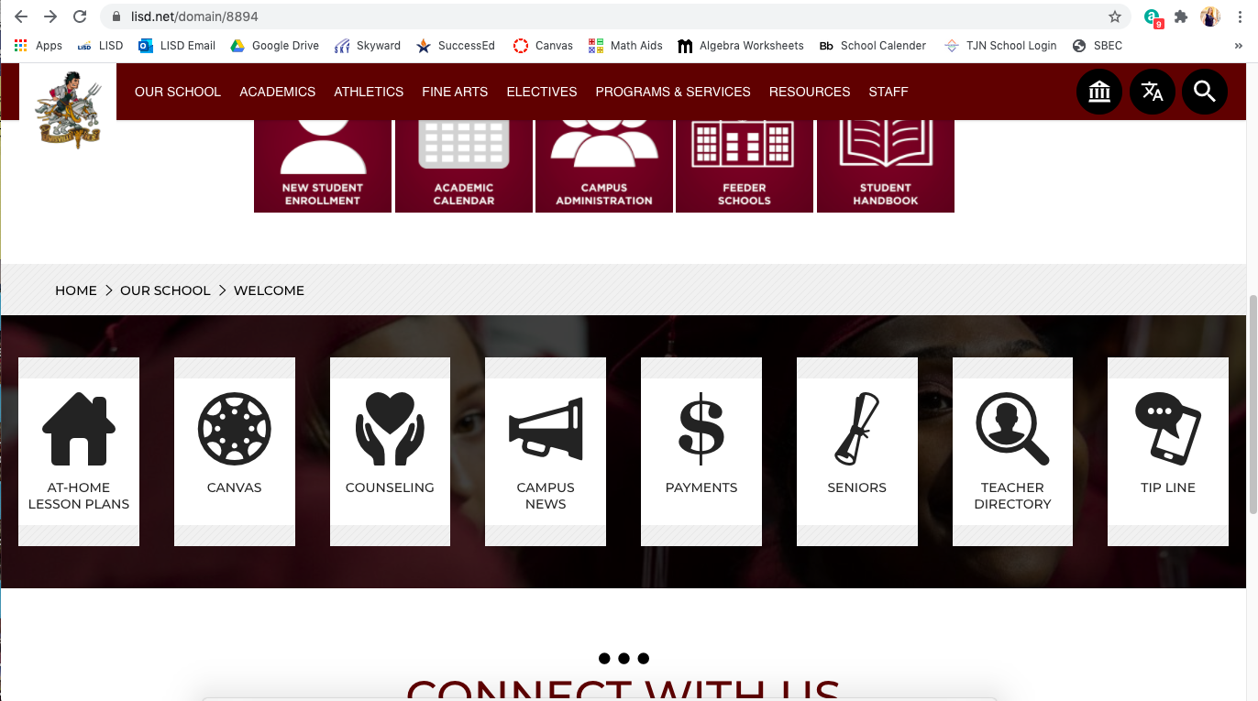
Step 2: Click on “Teacher Directory”, find your name and click on it.

Slide 3
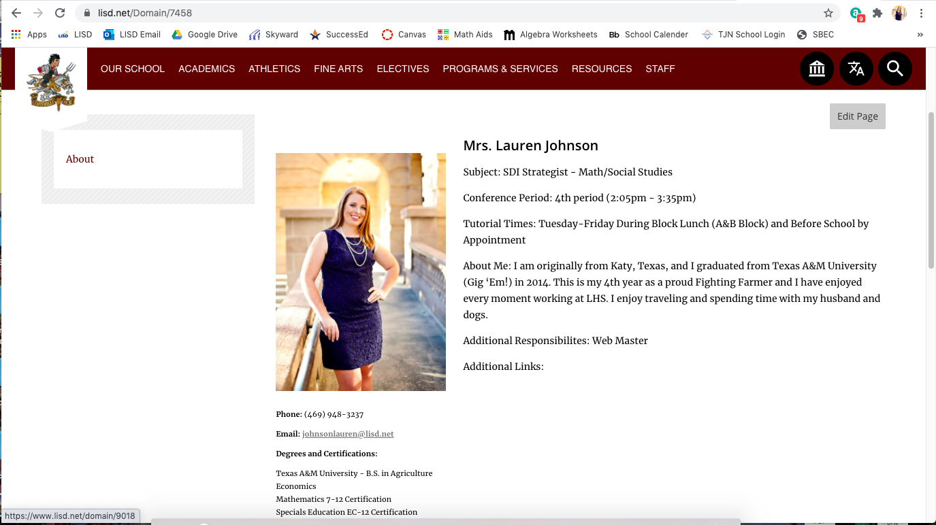
Step 3: Click on “Edit Page”

Slide 4
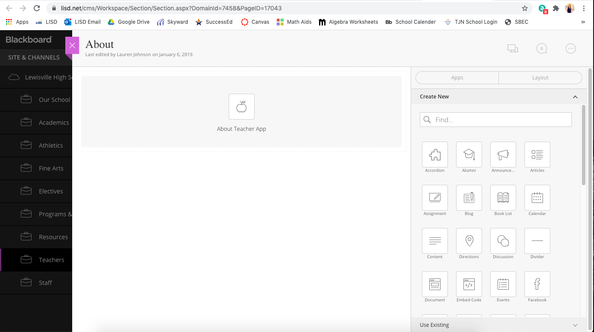
Step 4: Hover over the apple until you see a green pencil and click on it.

Slide 5
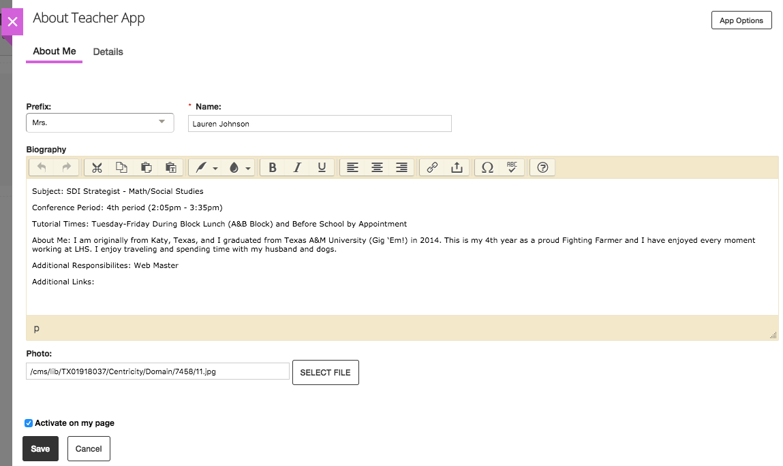
LHS Teacher Website
Complete your About Me section, add an appropriate photo of yourself, and update the “details” tab. Be sure to click save when you are done!
***For any website questions please contact Lauren Johnson or Allison Stamey.
Your “About Me” section should include at least the following items:
Subject Taught
Conference Time
Tutorial Times
About Me Section containing a couple sentence introducing yourself
For access or questions regarding athletics or club/activities pages please contact Lauren Johnson or Allison Stamey

